Slide 1
拥塞控制

Slide 2
Principles of Congestion Control
Congestion:
informally: “too many sources sending too much data too fast for network to handle”
different from flow control!
manifestations:
lost packets (buffer overflow at routers)
long delays (queueing in router buffers)
a top-10 problem!

Slide 3
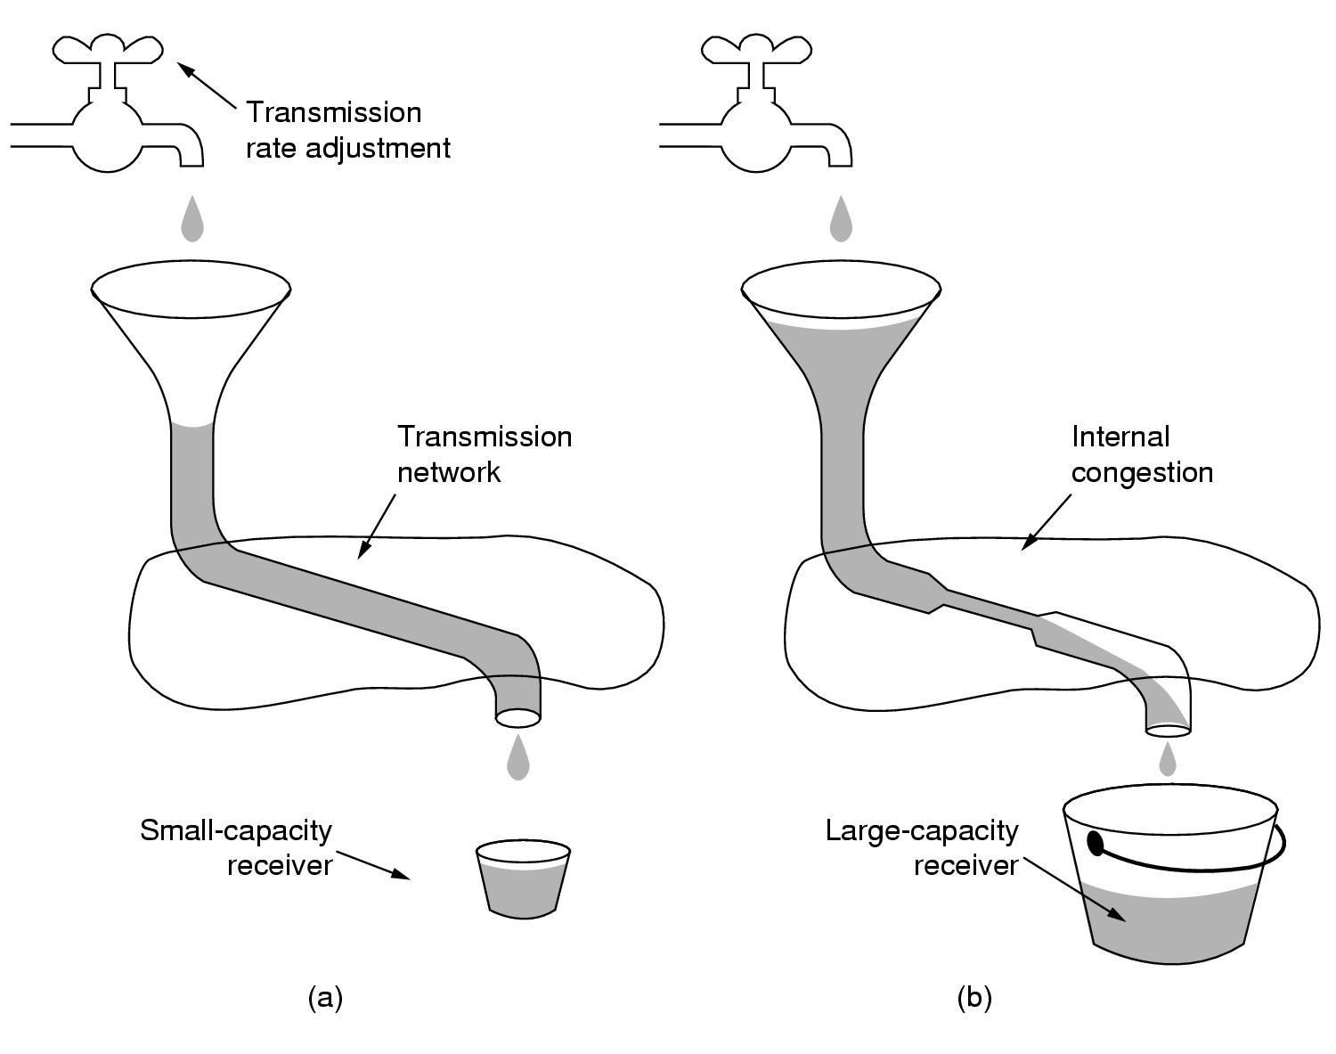
Principles of Congestion Control

Slide 4
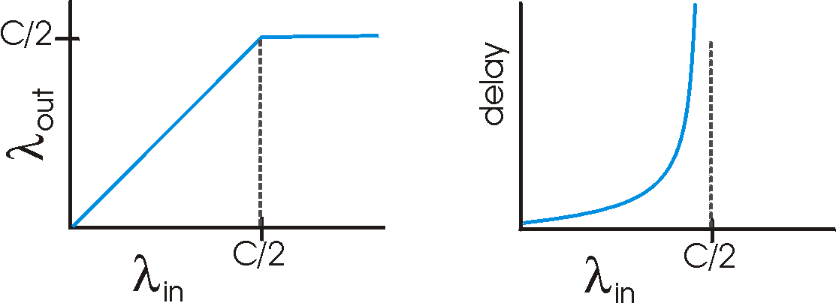
Causes/costs of congestion: scenario 1
Host A
λ_{in} : original data
λ_{out}
two senders, two receivers
one router, infinite buffers
no retransmission
Host B
unlimited shared output link buffers
large delays when congested
maximum achievable throughput

Slide 5
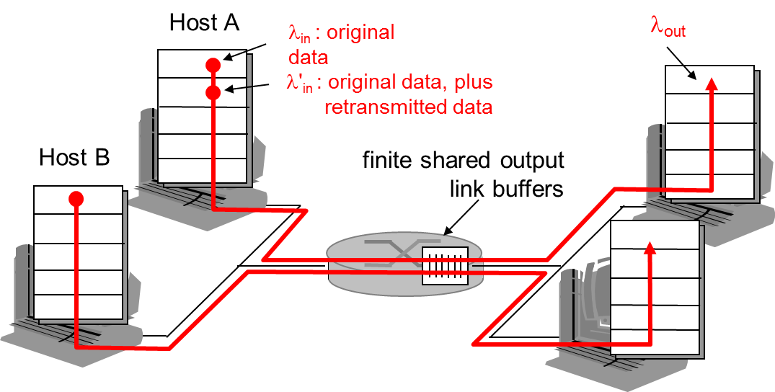
Causes/costs of congestion: scenario 2
one router, finite buffers
sender retransmission of lost packet

Slide 6
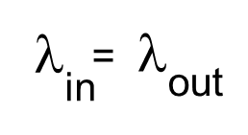
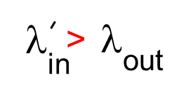
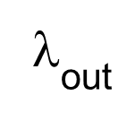
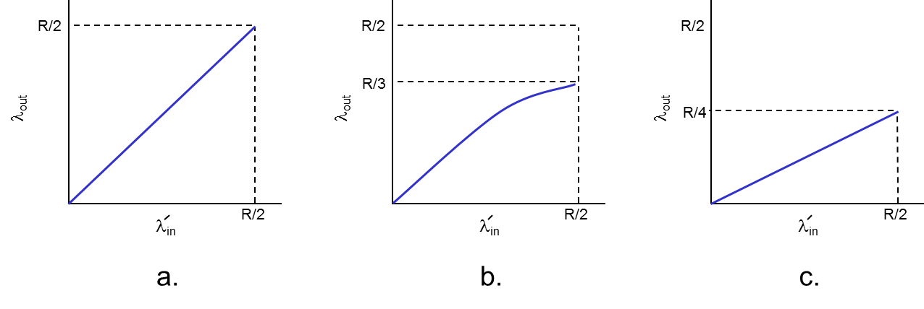
Causes/costs of congestion: scenario 2
always: (goodput)
“perfect” retransmission only when loss:
retransmission of delayed (not lost) packet makes larger (than perfect case) for same
“costs” of congestion:
more work (retrans) for given “goodput”
unneeded retransmissions: link carries multiple copies of pkt

Slide 7
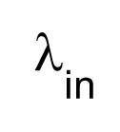
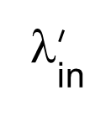
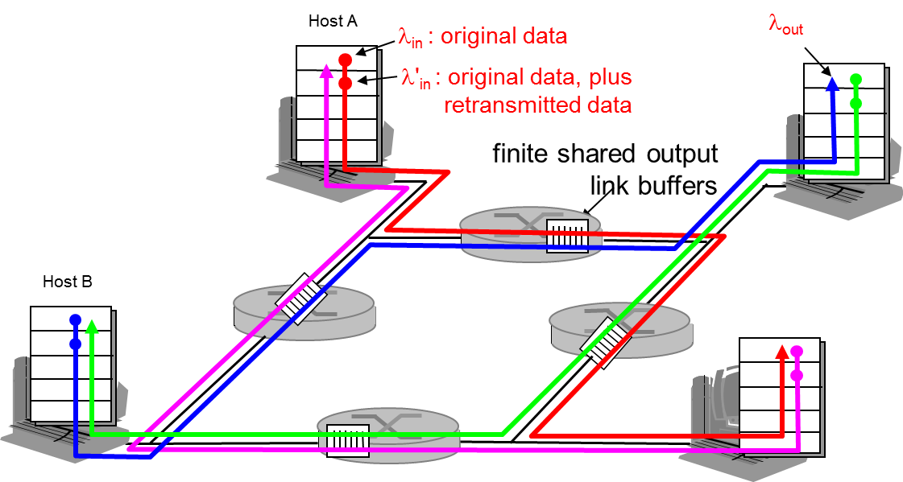
Causes/costs of congestion: scenario 3
four senders
multihop paths
timeout/retransmit
Q: what happens as and increase ?

Slide 8
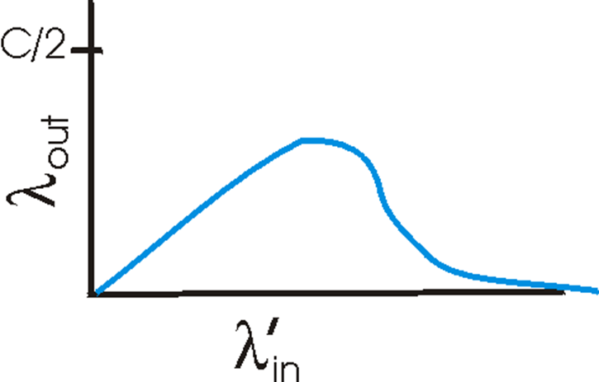
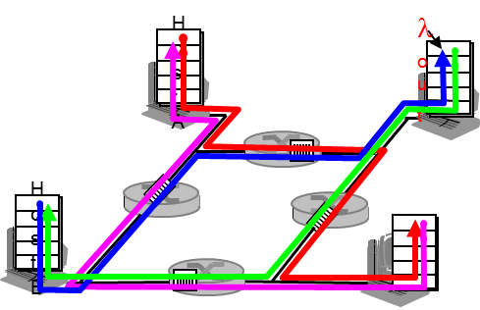
Causes/costs of congestion: scenario 3
Another “cost” of congestion:
when packet dropped, any “upstream transmission capacity used for that packet was wasted!

Slide 9
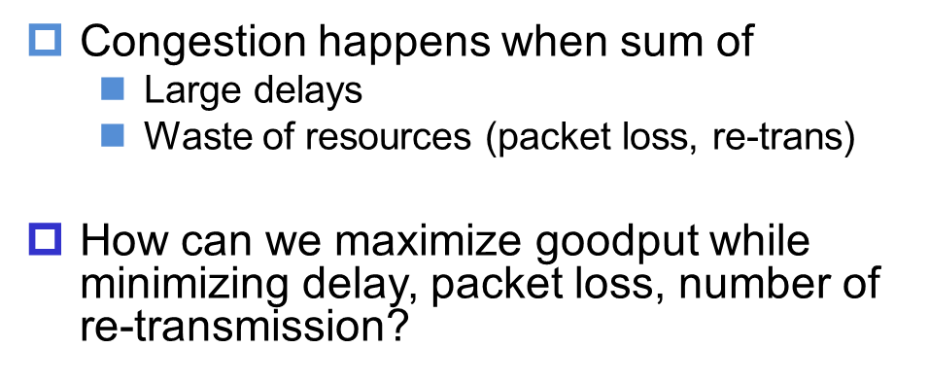
Question

Slide 10
Approaches towards congestion control
Two broad approaches towards congestion control:
End-end congestion control:
no explicit feedback from network
congestion inferred from end-system observed loss, delay
approach taken by TCP
Network-assisted congestion control:
routers provide feedback to end systems
single bit indicating congestion (SNA, DECbit, TCP/IP ECN, ATM)
explicit rate sender should send at
Open loop: no need for cong control in circuit switching. Why?

Slide 11

Summary
What’s Congestion?
Cost of Congestion

